Slide 1
IPR Term 1 Week 2
Intro to Research methods & Ethics
Dr Hayley Dewe
(Assistant Professor)

Slide 2
Learning Outcomes
Understand the importance of research methods in psychology.
Distinguish between different types of research methods
Understand key terms and concepts
Grasp the concepts of reliability, validity, and sample selection in research.
Recognize the significance of appropriate design and methods
Ethical considerations

Slide 3
Lesson Outline
This week, the lecture, online content will introduce you to…
Introduction to Research Methods
Types of Research Methods
Research Design: Variables
Research Design: Sampling
Reliability and Validity
Ethics in Psychological Research (Practical 1 and online content)

Slide 4

1. Introduction to Research Methods

Slide 5
Why are Research Methods important in Psychology?
Science of psychology is rooted in systematic observation and evidence
To systematically understand, test and analyse the behaviour and experience of others.
Direct or indirect application: shaping knowledge, advancing research, formulating theory or practice.
Advancing practical applications e.g., education, business, health

Slide 6
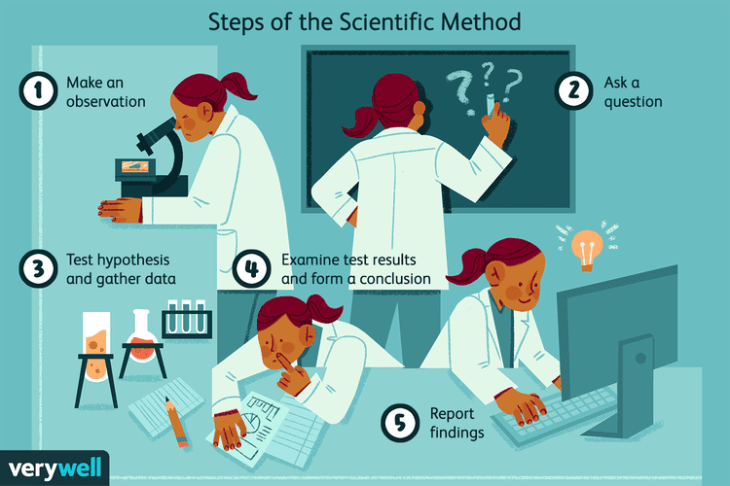
Key Concepts / Terms
Scientific Method: Psychologists follow a process to conduct research (hypothesis, theory, experiment, analysis, conclusion)

Slide 7
Key Concepts / Terms
Research: Overall process of inquiry (entire study, purpose, objectives and outcomes)
Empirical Research: original research based on observable and measurable behaviour (e.g. peer-reviewed journal article)
Design: How research will be conducted. Includes type of study, method of data collection and analysis)
Method: Specific techniques and procedures to collect and analyse data (e.g. tools).
Hypothesis: Clear, testable prediction or idea about what you expect to happen
Theory: Broader, established explanation of behaviour / experience based on multiple studies

Slide 8
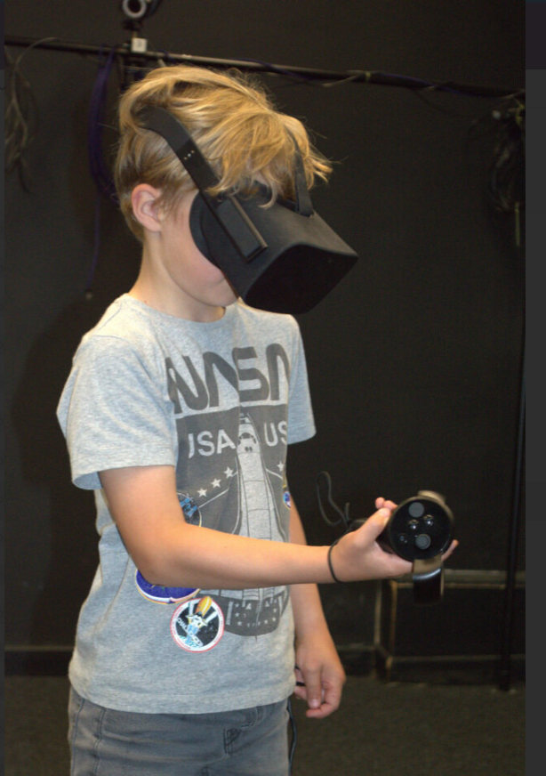
A multitude of behaviours and experiences Human Subject Research
Cognition and memory
Perception and vision
Environment
Motivation and reward
Eating behaviours
Child development
Aggression, fear
Spatial learning
Attention
Leadership, status and power

Slide 9
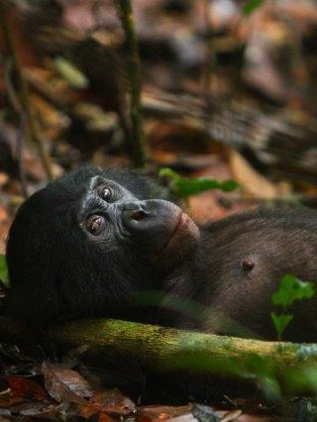
A multitude of behaviours and experiences Animal Research
Evolution of language and vocal communication
Animal cognition
Social cognition
Primate behaviour
Spatial learning

Slide 10
2.
Types of Research methods

Slide 11
Overview of Research Methods
It’s more than a method!
It determines how data are collected and analysed!
Consider the nature of the data (qualitative vs quantitative) or the design (experimental vs non-experimental)
Quantitative
Qualitative
Numerical data, to quantify variables, statistical estimation or inference
Non-numerical data (e.g. descriptive, words, experiences, behaviours)

Slide 12
Types of Research Designs
Experimental
Manipulate, control variables
Cause and effect relationships
Manipulate, without random assignment
Non-Experimental
To observe and describe, no manipulation Subtypes:
Quantitative
Quasi-Experimental
Some cause and effect relationships
Example: lab experiments
Example: real-world settings e.g. healthcare
Correlational (relation between variables, no causality)
Descriptive (characteristics of behaviour)
Survey (collect self-report data)
Observational (natural settings, numeric)

Slide 13
EXAMPLES
Types of Research Designs
Experimental
Non-Experimental
Quantitative
Quasi-Experimental
Does getting only 4 hours of sleep per night for a week impair cognitive performance compared to 8 hours? E.g. randomly assign participants: Group 1: 4 hours, Group 2: 8 hours sleep measure performance
Do medical interns working nights (vs. day shifts) show more cognitive errors due to sleep deprivation? E.g. compare interns already assigned on their error rates.
Correlational: Is there a relationship between average sleep duration and academic performance in university students?
Descriptive: What are the typical sleep habits of university students during exam season? Survey: How do students perceive the impact of sleep deprivation on their mood and productivity? Observational: How often do students fall asleep during lectures after pulling an all-nighter?

Slide 14
Types of Research Designs
Ethnography
Immersion: researcher embeds themselves in the culture/daily life of the participants (e.g. sharing behaviours, language)
Phenomenology
Studying an event or activity as it happens from different perspectives/insights – lived experiences of a phenomenon
Case study
In-depth understanding of one participant (or small number of pps). Contextual – detailed information.
Qualitative
Narrative
Gathers data from one or more participants through interviews etc. over time
Focuses on the experience of individuals (e.g. students as they progress through university)

Slide 15
EXAMPLES
Types of Research Designs
Ethnography
Phenomenology
Case study
Qualitative
Narrative
How do night-shift nurses navigate and adapt to chronic sleep deprivation in hospital settings? E.g., researcher spends time at the hospital, observing.
What is the lived experience of university students coping with sleep deprivation during exam season? E.g., in-depth interviews.
How does chronic sleep deprivation affect the daily functioning and well-being of a university lecturer? ☺ E.g., interviews or sleep diaries, teaching hours etc.
How does a first-year university student’s experience of sleep deprivation evolve over the course of their academic year? E.g., regular interviews / journal entries on performance and wellbeing

Slide 16
Pros and Cons
Method | Design | Pro | Con
Quantitative | Experimental | Cause-and-effect Objective, replicable, measurable | Ecological validity. Oversimplifying complex phenomena, lack depth.
 | Longitudinal | Changes over time | Time-consuming, expensive
 | Correlational | Relationships and associations | Can’t prove causality
 | Descriptive | Large data, quickly | Bias or unreliable responses
Qualitative | Case studies | Detail from unique cases | Limited generalisability, small samples
 | Interviews | In-depth rich data, captures meaning | Time-consuming (collection and analysis)
 | Observational | Natural setting | Observer bias
 | Thematic | Patterns and themes – rich | Researcher bias, subjective interpretation

Slide 17

When to use what?
Quantitative
Qualitative
Focus on what and how much
Tests theories and hypotheses
Data is analysed using statistical methods
Focus on why and how
Generates theories based on data
Data analysed via categorisation and interpretation

Slide 18
When to use what?
Quantitative
Qualitative
If you want to quantify behaviour
Establish general patterns
Test specific theories or hypotheses
Explore new research areas or phenomena
Understand deep psychological processes
Study individual experiences
Or combine: Mixed Methods research

Slide 19

Again, why is all this important?
Ensures study is well-thought out
Valid and reliable
Addresses your research question
Draw appropriate and accurate conclusions about our measures
Minimise bias
Increase generalisability

Slide 20
3. Research Design: Variables

Slide 21
Research Design: Variables
Experimental research
Defining Variables:
Independent Variable (IV): what we change or manipulate
Dependent Variable (DV): our outcome, what we measure
To see if changes to the IV affect the DV
Extraneous Variable: Other factors that could influence the DV but are not the main focus (should be controlled for)
Confounding Variable: overlaps with the IV and affects the DV (potentially distorting the findings)
Demand characteristics: participants change their behaviour

Slide 22
Controlling for Extraneous variables
But experimental research is considered one of the more ‘controlled’ designs, right?
So how do we control these pesky extraneous variables?
To control for or eliminate the influence of these variables on the DV

Slide 23
Controlling for Extraneous variables
Control groups: another group of participants that does not receive the manipulation to the IV
Randomization: randomly assign participants to different groups/conditions
Matching: pairing / grouping participants based on certain characteristics
Statistical control: statistical techniques to account for these effects
Holding variables constant: keep variables constant throughout the study
Pre-screen Participants: Ask participants to meet a certain criteria to help reduce variability

Slide 24

A note on Operationalization
Operationalizing variables = making them measurable or quantifiable
Our variables need to be in a form that we can measure / test
Some constructs are not directly observable (e.g., anxiety)
e.g., we can’t really measure ‘hallucinations’, but we can measure certain factors (e.g., frequency, mode, content)

Slide 25
4. Research Design: sampling

Slide 26
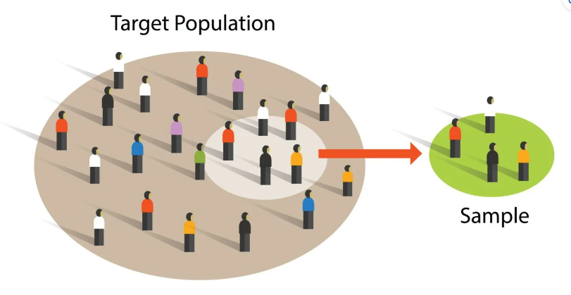

What is Sampling?
Selecting a sample (participants)
Individuals or a group of people from a target population to make inferences about the entire / larger population
To ensure findings are:
Representative: sample matches the target population
Generalisable: findings can be applied to the larger population (of which the sample was a part of
Only if it is intended!

Slide 27
Types of Sampling
Volunteer
Participants sign up through adverts
People who are available and willing to take part
Random
When everyone (from the target population) has an equal chance of being picked
Systematic
A system / rule to pick participants e.g., the Nth person from all possible participants
Opportunity (or convenience)
There’s a lot! Here’s some that you’re most likely to come across

Slide 28
Poor Sampling
….can negatively affect research
Increase Bias e.g., for a health survey, you only recruit in Gyms you’ll overrepresent those who are more health consciousness
Reduce Generalisability can’t go beyond the sample (e.g. evaluating a new health app but on Gym goers only)
Lack Reproducibility e.g., findings may not be upheld in a broader sample

Slide 29
Poor Sampling
….can negatively affect research
Misleading correlations e.g., if some groups are over- or under-represented in the sample
Decrease statistical Power: sample may lack size or diversity to detect real effects (fails to find an effect that is present)
Ethical implications: if a certain demographic are consistently excluded from research (W.E.I.R.D samples)

Slide 30
5. Reliability and Validity

Slide 31
What are they?
Reliability
Validity
Consistency of a measure
Is it replicable and reliable?
Stable and consistent results in different contexts
Accuracy of a measure
Does it measure what’s it meant to?
Drawing appropriate and correct conclusions

Slide 32
Types of Reliability
Test-Retest
Test produces similar results over time. e.g. same person on two different occasions
Degree of agreement among different raters when independently assessing or evaluating the same phenomenon
Internal consistency
How well the items on the test (e.g. questions on a survey) measure the same concept
Inter-Rater

Slide 33
Types of Validity
Face
It appears to measure what it’s meant to
It appears to measure the theory / construct it’s meant to
Criterion
How well one measure predicts an outcome based on another measure
Construct
External
If findings can be generalised / relevant in other contexts

Slide 34
Threats to Reliability and Validity
Demand characteristics
Bias
Social desirability bias
Experimenter effects

